Slide 1
html tags
MCNDHS
Ms. Eng

Slide 2
aim: changes to content
Do now:
Daily Grade:
On-time/attendance/not leaving the classroom: 25%
Cellphones: 25%
Notes:25%
Classwork/Homework: 25%

Slide 3

look at this design
Can you determine what the image is trying to advertise?

Slide 4

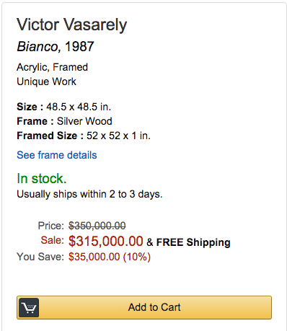
another example…

Slide 5
Cross out the line
To delete content: <del> </del>
To insert content: <ins> </ins>

Slide 6
activity
A student started school with this mentality but ended up with the following:

